Slide 1
Computer Vision
Part 1

Slide 2
Computer vision: Can we teach computers/machines to do the same?

Slide 3
Representation learning: why, what and how of CNNs
MLP for image processing and classification → Good enough?
Mnist: 28P x 28P = 784P. Iphone 11 pic resolution: Mega-Ps. How big must our neural network be?
Do neighboring pixels have correlations with one another?
Can we represent images better???
YES! CNNs!(convolutional neural networks)

Slide 4
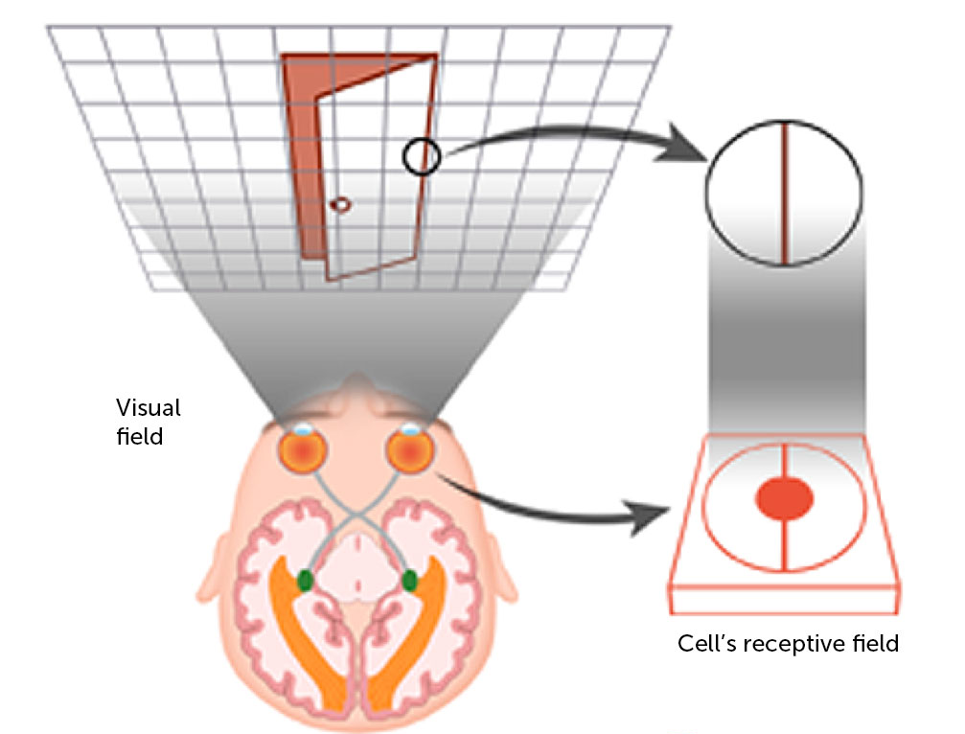
Representation learning: why, what and how of CNNs

Slide 5
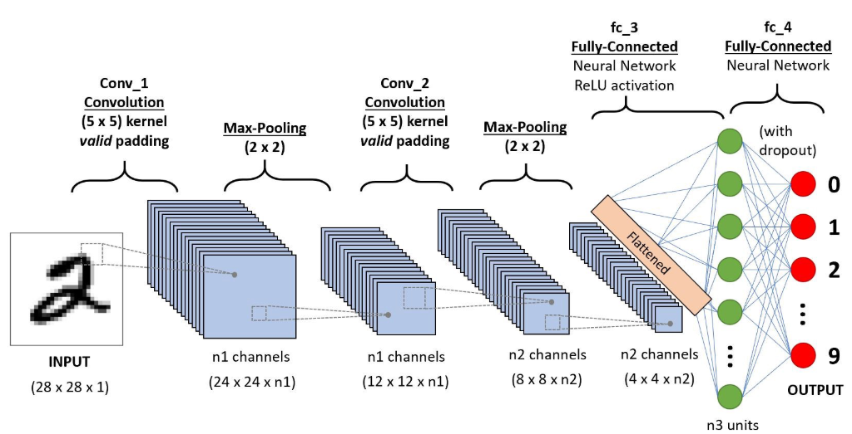
Representation learning: why, what and how of CNNs
2 operations to each convolutional layer: a convolution and a pooling operation

Slide 6
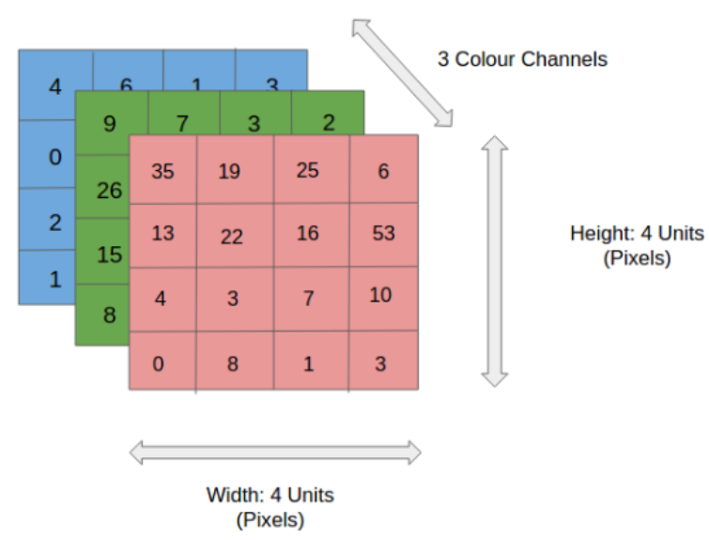
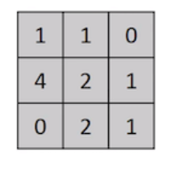
Representation learning: why, what and how of CNNs
Notes:
https://towardsdatascience.com/a-comprehensive-guide-to-convolutional-neural-networks-the-eli5-way-3bd2b1164a53

Slide 7

Representation learning: why, what and how of CNNs
Part 1: The kernel
Feature map

Slide 8

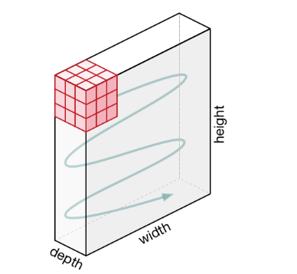
Representation learning: why, what and how of CNNs
Part 1: The kernel
N.B. Zero padding is used here

Slide 9



Slide 10
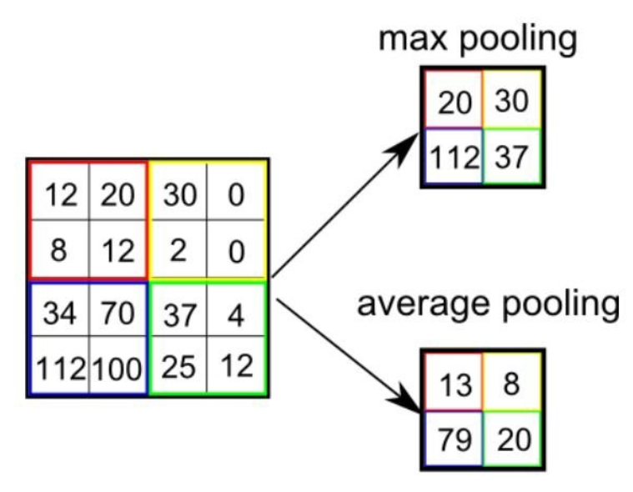

Representation learning: why, what and how of CNNs
Part 2: The pooling layer
N.B. Max pooling is generally better

Slide 11
Representation learning: why, what and how of CNNs
Hyperparameters:
Padding: Same or Valid
Stride length (for both convolution and pooling)
Filter size (for both convolution and pooling)
Number of filters
Pooling: Max or Average

Slide 12
28 x 28 x 1
Kernel convolution with 12 filters, valid padding, stride 1, filter size 5 x 5
Putting it together into ONE convolutional layer...
24 x 24 x 12
Activation function (e.g.Relu)
24 x 24 x 12
Max pooling layer of size 2 x 2
12 x 12 x 12

Slide 14
Practice Keras!

Slide 15
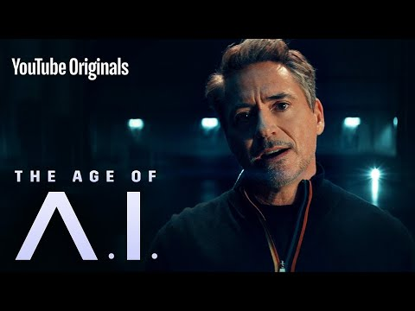

Slide 16
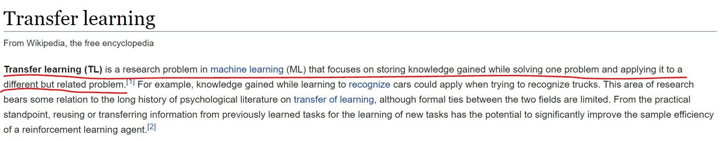
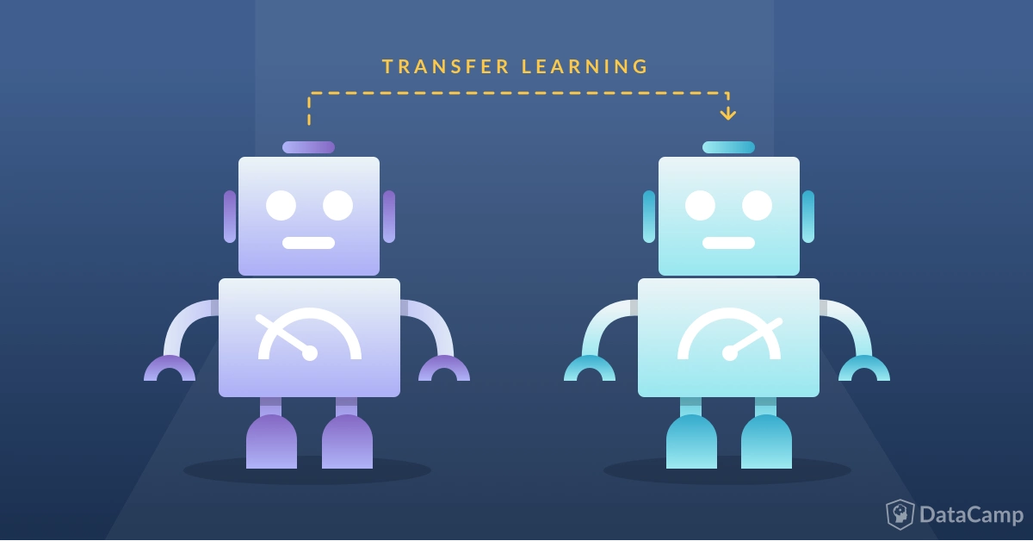
Transfer learning
???
Know how to ride a motorbike ⮫ Learn how to ride a car
Know how to play classic piano ⮫ Learn how to play jazz piano
Know math and statistics ⮫ Learn machine learning
Notes:
https://towardsdatascience.com/a-comprehensive-hands-on-guide-to-transfer-learning-with-real-world-applications-in-deep-learning-212bf3b2f27a
https://www.datacamp.com/community/tutorials/transfer-learning

Slide 17
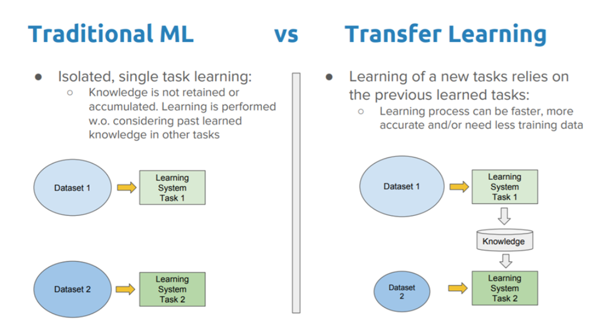
Transfer learning
The general idea of transfer learning is to use knowledge learned from tasks for which a lot of labelled data is available in settings where only little labelled data is available.
Keras provides us with pretrained models that allow for fast and efficient transfer learning!
AlexNet
VGG
Inception
ResNet
MobileNet
Notes:
https://keras.io/applications/
https://cv-tricks.com/cnn/understand-resnet-alexnet-vgg-inception/
https://dataconomy.com/2017/04/history-neural-networks/

Slide 18
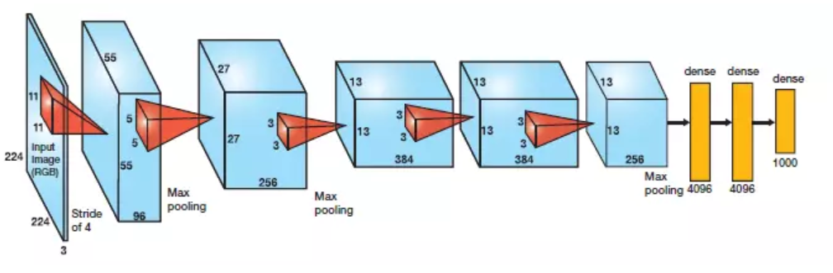
ALEXNET
Advantages:
Dropout layers
Relu activations
Same padding
Max pooling
Parallelized GPU training

Slide 19
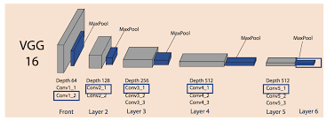
VGGs
Advantages:
Multiple stacked conv filters
Consistently sized filters and layers

Slide 20
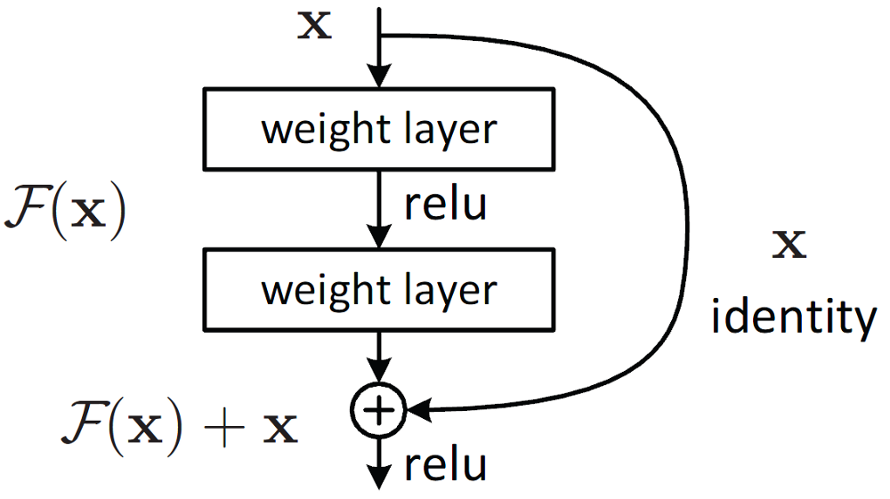
ResNets
Advantages:
Deeper without vanishing gradients

Slide 21
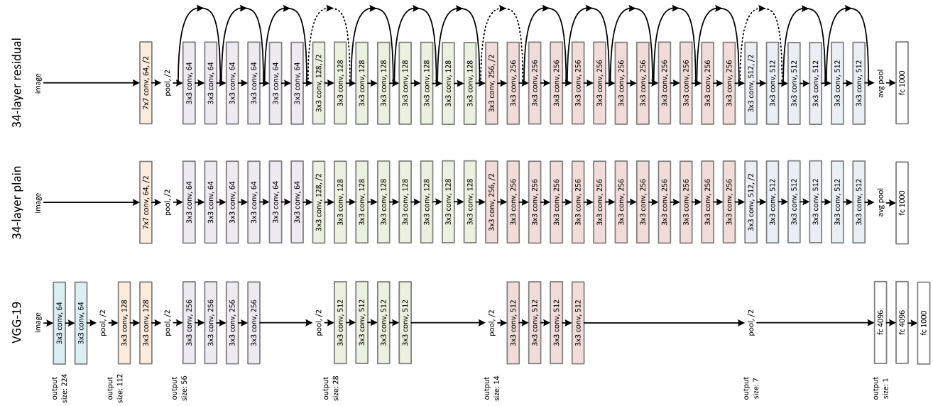
ResNets

Slide 22
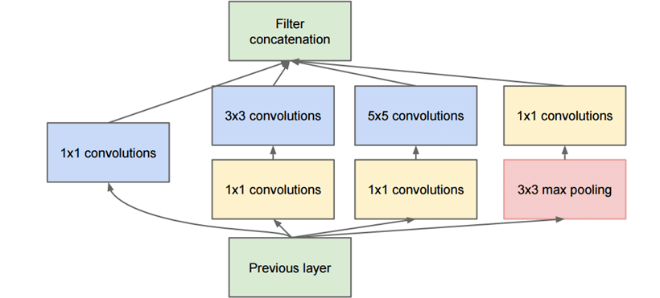
Inception
Advantages:
Wider
Less computationally expensive

Slide 23
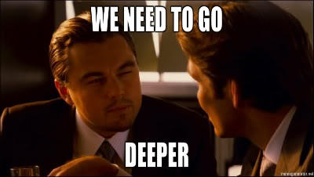

Slide 24
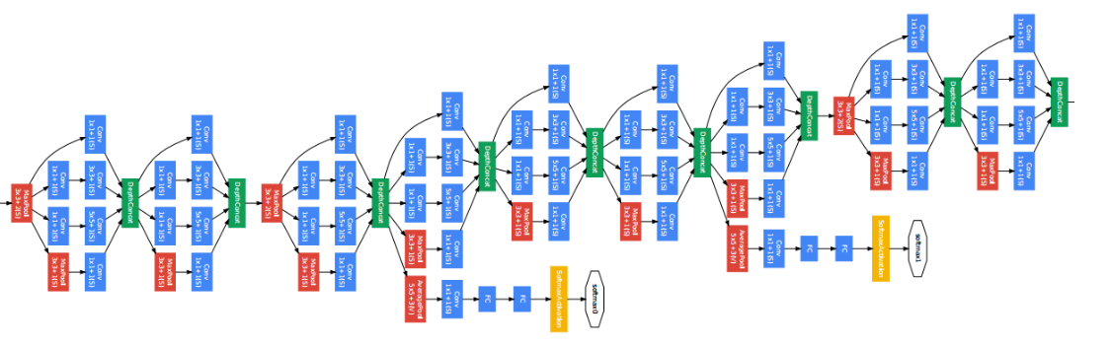
Inception

Slide 25
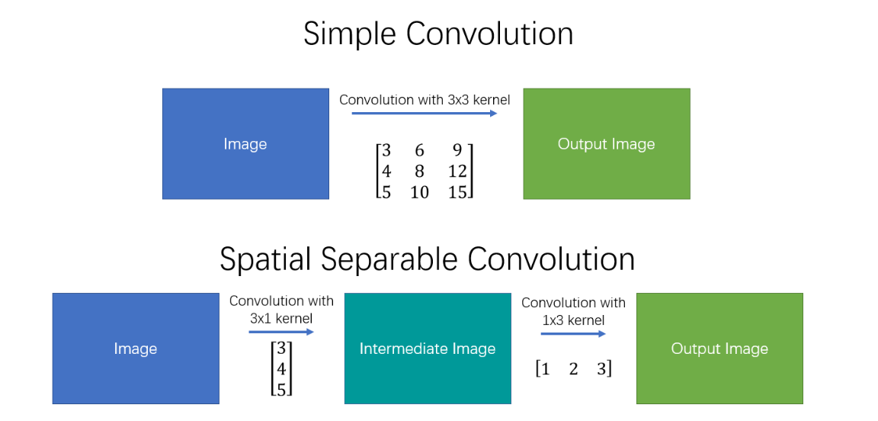
Xception

Slide 26
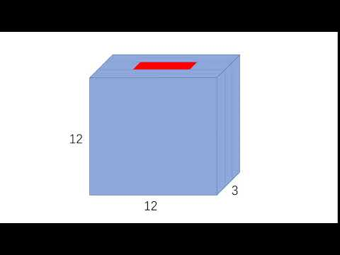
Depthwise convolution

Slide 27
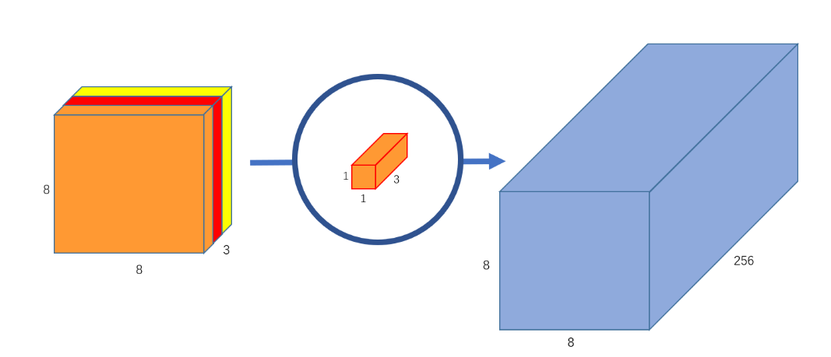
Pointwise convolution

Slide 28
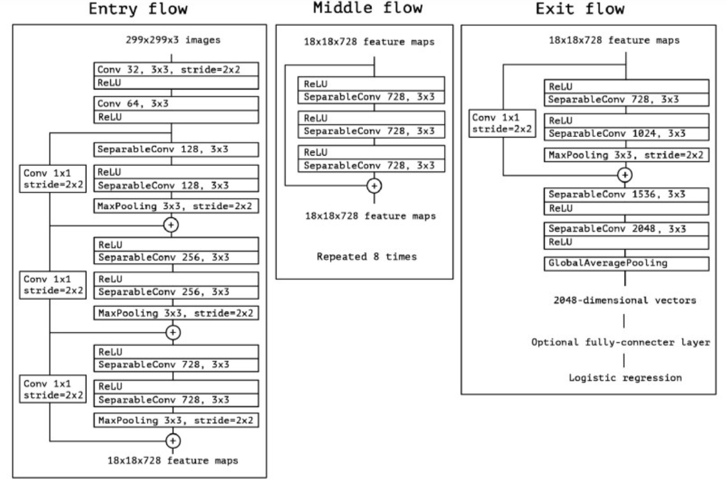
Xception

Slide 29
And still...so many more!!!
Squeezenet: Rehash of inception + resnet concepts
Enet: used for real time segmentation tasks in mobile applications
Unet: specifically for biomedical image segmentation tasks
Notes:
https://towardsdatascience.com/a-comprehensive-introduction-to-different-types-of-convolutions-in-deep-learning-669281e58215

Slide 30
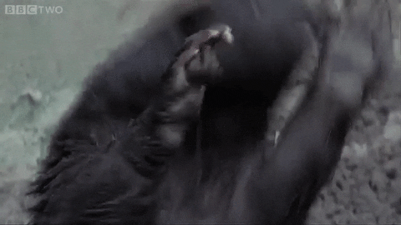
It’s Badger Time!

Slide 31
Situation:
While the entire REP cohort was too busy studying for finals last year, a secret army of mutated badgers escaped from the zoo and infested North Hill! In order to stop them, REPO has enlisted your help in deploying smart cameras in the area to track their movements.
Task:
Develop an algorithm that can help identify and classify these mutated badgers.

